Slide 1
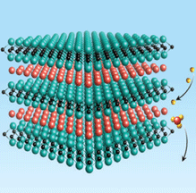
Integrating Omics and Literature to Map AOPs for MXenes: From Differential Expression to Adverse Outcomes
Asmaa Ali - Research Data Scientist @ EwC
Notes:
Hello everyone! I’m Asmaa Ali, a Research Data Scientist at Edelweiss Connect (Switzerland), and I’m delighted to be here on my CompSafeNano secondment. This presentation introduces my early work on MXenes—integrating RNA-seq with the published evidence base to place gene-level changes within the AOP framework and try to highlight mechanisms that may lead to adverse outcomes.

Slide 2
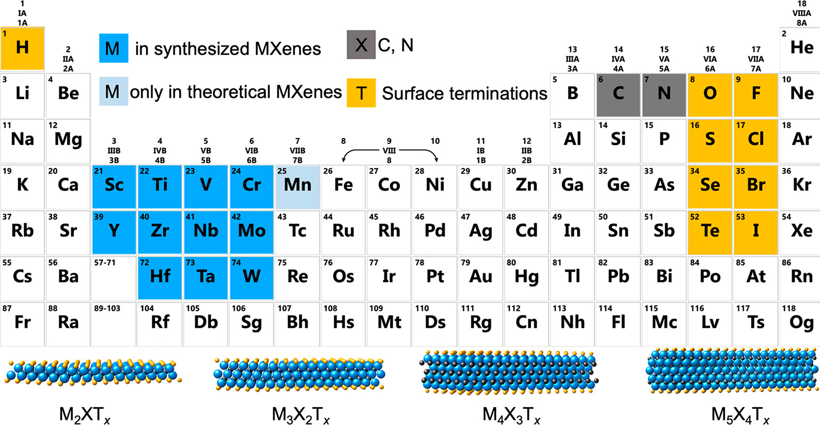
What are MXenes?
2D nanomaterials from carbides, nitrides & carbonitrides & First discovered in 2011 (Ti₃C₂)
General formula: Mₙ₊₁XₙTₓ
M (Transition Metal): Ti, V, Mo, Nb…
X: C or N
Tₓ (Surface Terminations): –O, –OH, –F, –Cl
In addition to M, X, and T, MXenes also have structural variations (n, stacking, T position)
>4,000 possible structures
ACS Nano 2021, 15, 4, 5775-5780
Notes:
MXenes are a new family of 2D nanomaterials discovered in 2011, with the general formula Mₙ₊₁XₙTₓ. Here, M is a transition metal, X is carbon or nitrogen, and T are surface terminations like –O, –OH, or –F.
“In addition to M, X, and T, MXenes also have structural variations.
The value of n controls how thick the sheets are. Stacking refers to how the atomic layers are arranged — either like ABC or ABA — which affects stability and conductivity. And the T position describes where the surface terminations attach on the MXene surface, which is key to tuning their chemistry for different applications.”
As shown in the periodic table, there are thousands of possible MXene structures, giving them enormous chemical diversity.
What makes them exciting is their unique combination of properties: 💧 They are hydrophilic, ⚡ highly conductive, 🔧 and have tunable surface chemistry.
This makes MXenes ideal for applications in energy, electronics, sensors, and biomedicine — and that’s why I chose to focus my research on them.

Slide 3
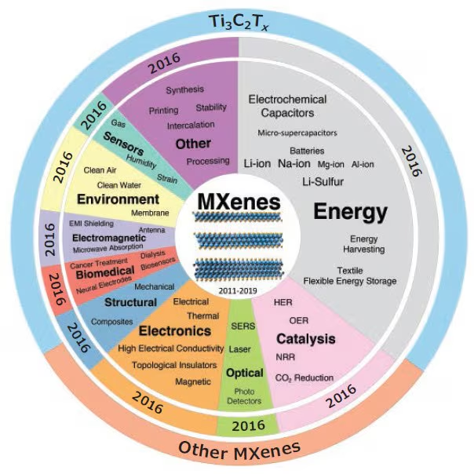
Why MXenes?
Growing research interest: many publications since discovery in 2011.
Unique structure: 2D transition metal carbides/nitrides with high surface area.
Versatile properties: conductivity, hydrophilicity, surface functionalization.
Real applications: energy storage, electronics, environment, catalysis, biomedical.
Src:https://www.sigmaaldrich.com/EG/en/technical-documents/technical-article/materials-science-and-engineering/organic-electronics/mxenes?srsltid=AfmBOoqipPHrhC-d25nhr2PCKAzTuluRurbxbR6JRbOvx7EBL8lQoWXz
Notes:
Now—why focus on MXenes? Their structural variability (metal, layer number, terminations) makes their chemistry highly tunable, which can translate into diverse biological effects. At the same time, MXenes are moving rapidly into real applications, increasing the likelihood of human and environmental exposure.
With a bridge to your methods Because of this variability and growing use, we need mechanism-aware assessment—hence mapping RNA-seq signals into AOPs to see which pathways and outcomes are plausibly engaged.

Slide 4
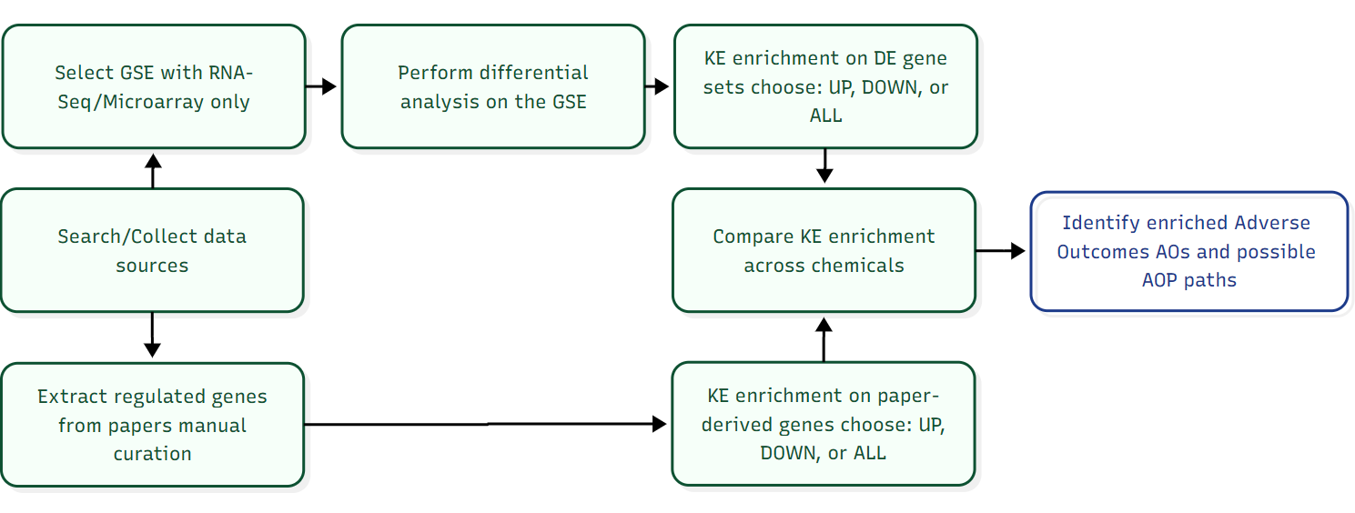
Hypothesis & Aim
Hypothesis
MXenes trigger mechanism-specific gene expression programs that can be organized within the AOP framework. By integrating RNA-seq DEGs with literature-extracted gene sets, we can reveal key events (KEs) and plausible paths leading to adverse outcomes (AOs)—and compare them across MXenes.
Aim of the Study
Map MXene-induced molecular changes to AOP KEs/AOs by combining omics and literature evidence, and identify shared vs. material-specific mechanisms.
AB, ABC
Notes:
Add problem formulation before this slide
=> Breakdown of the main GEO accession prefixes:
GSE → GEO Series
A series represents a complete experiment or study, often consisting of multiple samples.
Example: GSE12345
It links together several GSM (Sample) records and describes the overall experimental design and context.
GSM → GEO Sample
A sample corresponds to a single experimental unit (e.g., one RNA-seq or microarray sample).
GPL → GEO Platform
A platform represents the technology or array used (e.g., Affymetrix, Illumina).
GDS → GEO DataSet
A data set is a curated collection derived from one or more series, processed for easier comparison and analysis.
Example relationship: A GSE (series) contains multiple GSMs (samples), all measured on one or more GPLs (platforms), and may later become part of a curated GDS (dataset).

Slide 5
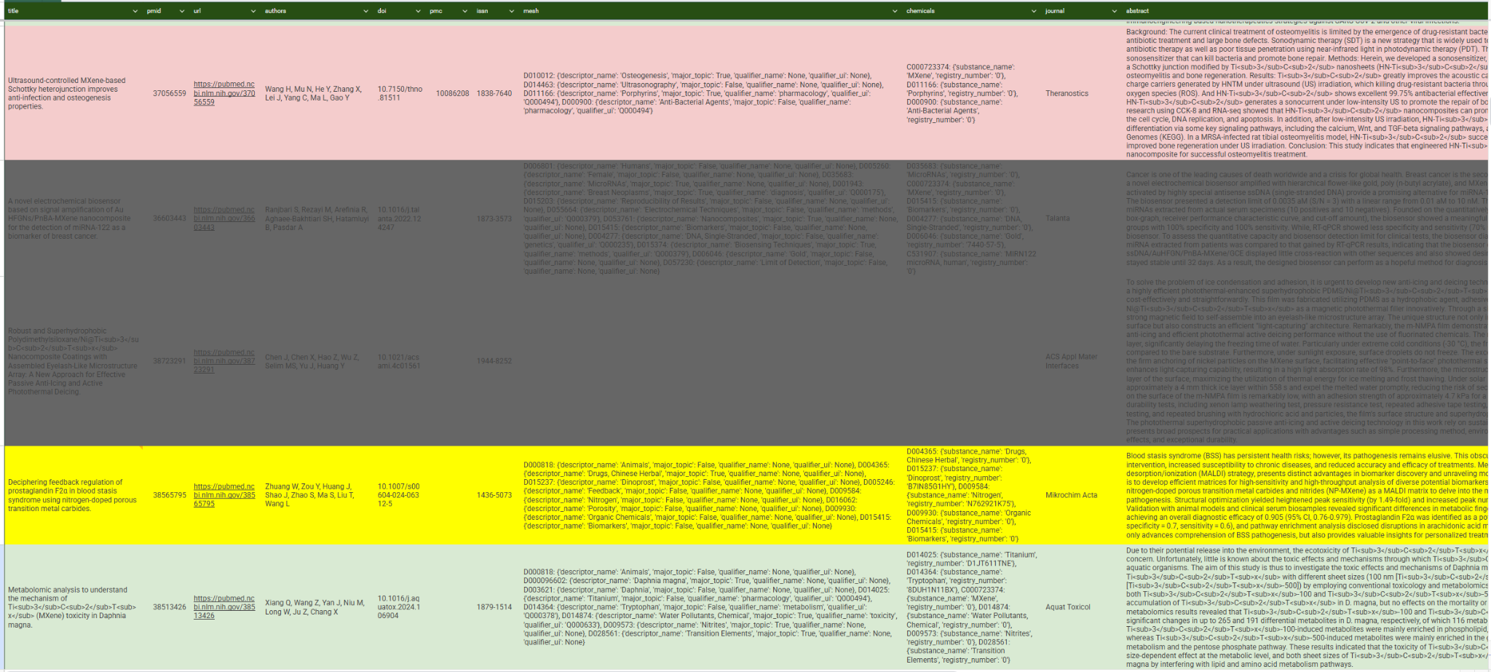
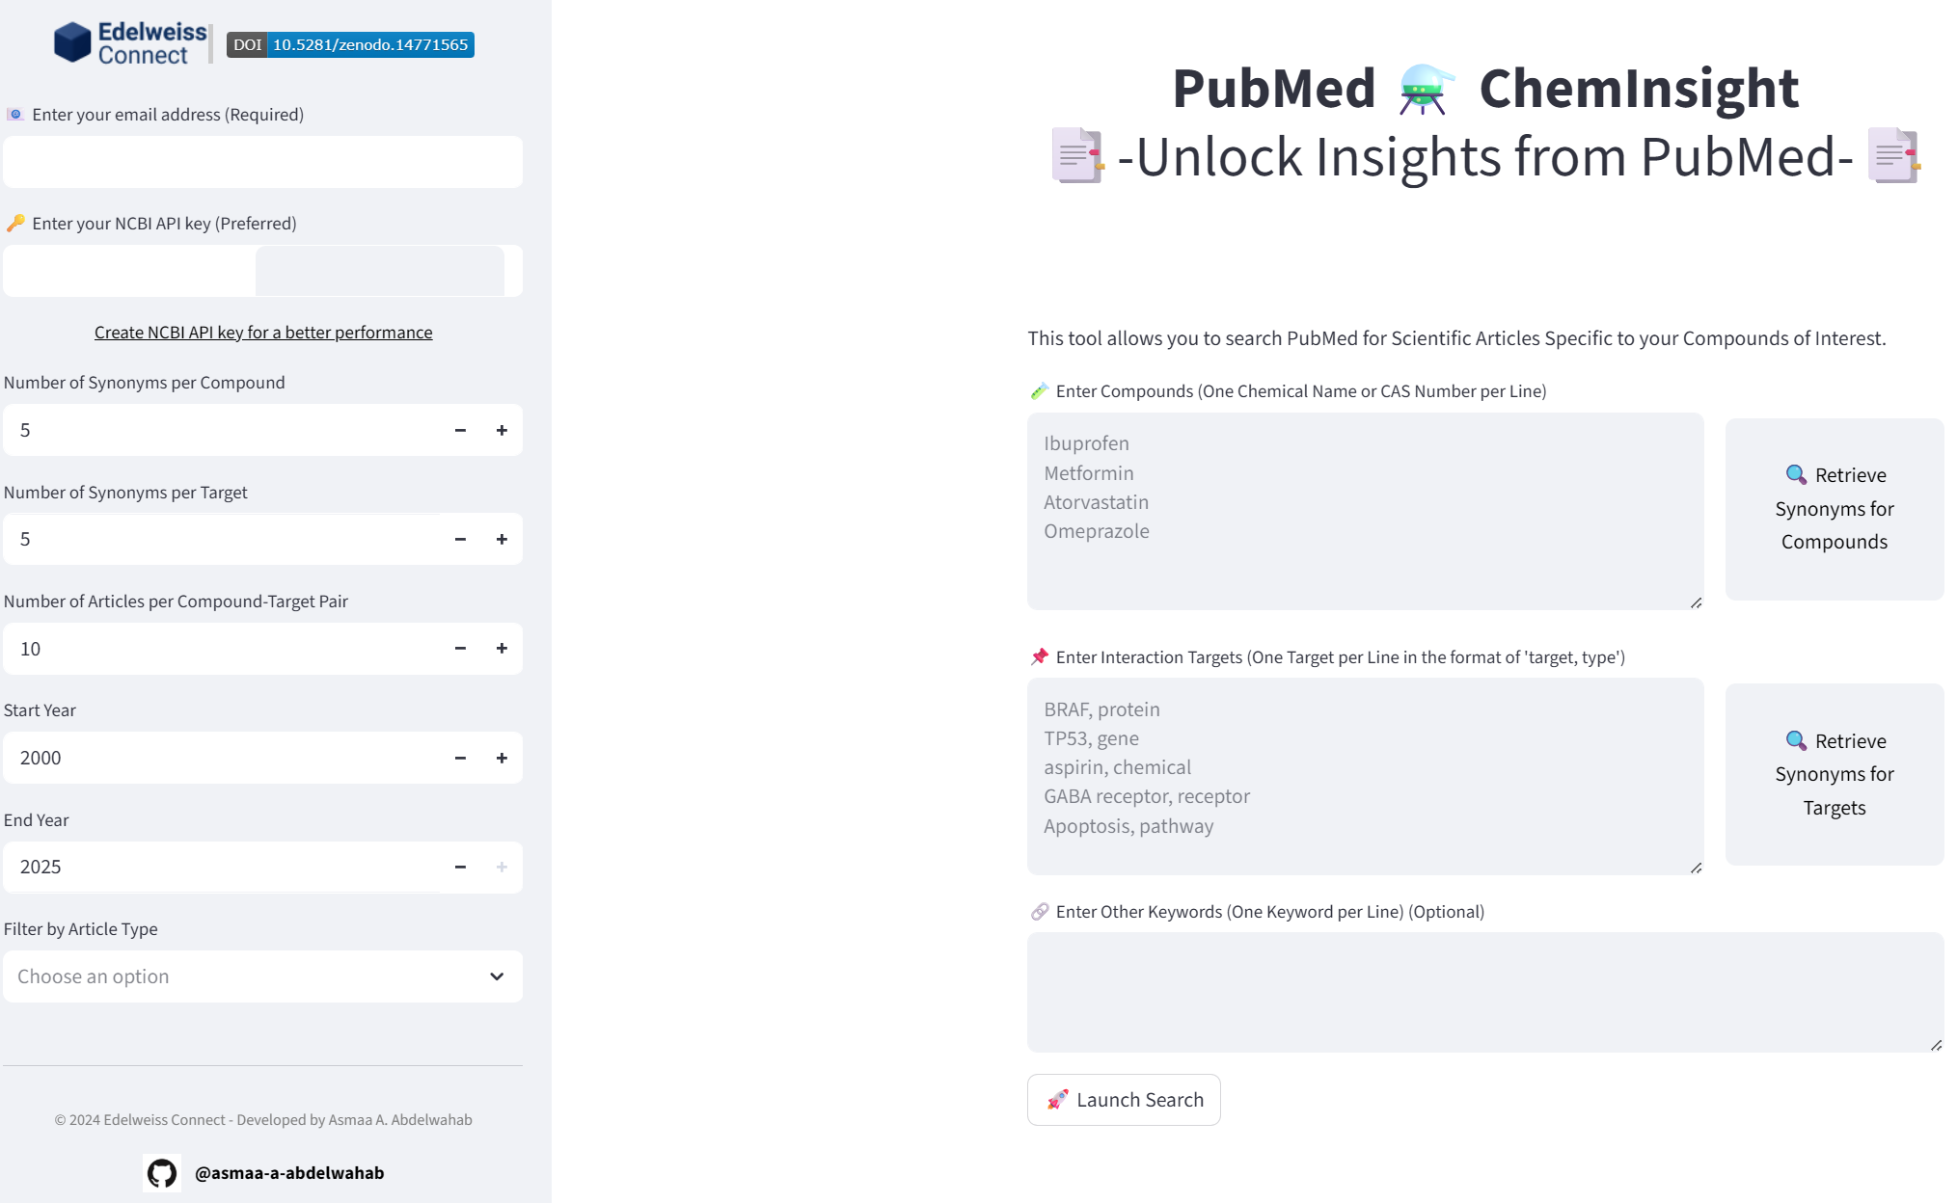
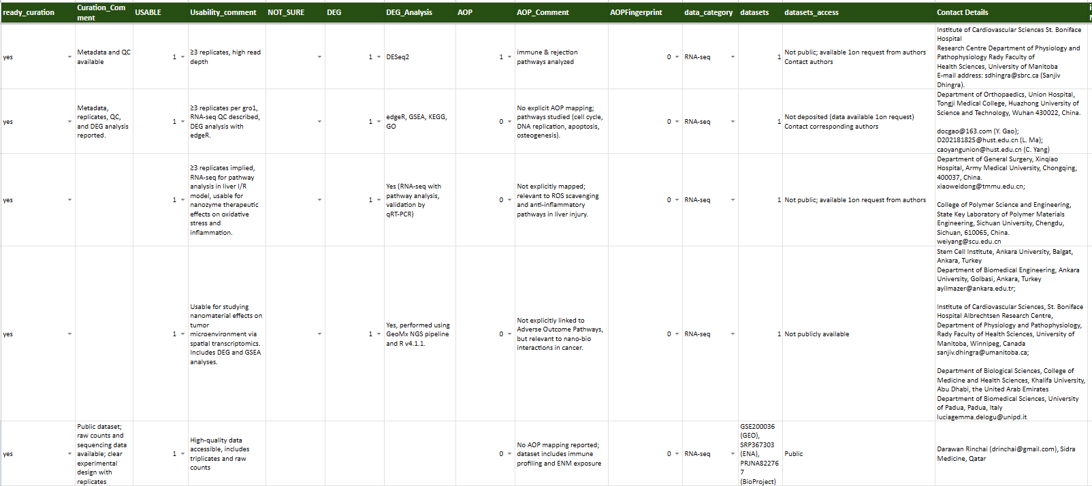

Data Sources & Curation
https://pubmed-cheminsight.edelweissconnect.com/
URL1
Under Development
URL2

Slide 6
Summary of Collected & Selected Datasets
📊 Coverage: 5 data sources - 1 Public (GSE200036) with no reference paper - 4 Paper where datasets are available on request
🧬 Assay Types - 4 RNA-seq - 1 Spatial transcriptomics
🧑🐭 Organisms - Human (2) - Mouse (2) - Mixed Human+Rat (1)
⚗️ System/Setting - In vitro (2) - In vivo (2) - Mixed (1)
✨ Selected: - 1 Public dataset (GEO: Ta4C3, Mo2Ti2C3, Nb4C3) - 2 papers (Ti3C2Tx, HN-Ti3C2)
🔧 Processing Workflow - 📂 GEO - Fastq files → QC - 📊 GEO - Raw counts → DE Analysis & Enrichment - 📑 Literature DEG lists → Enrichment (authors contacted)
Notes:
Cross-species -> KGs + toxicogenomics + biological pathways

Slide 7
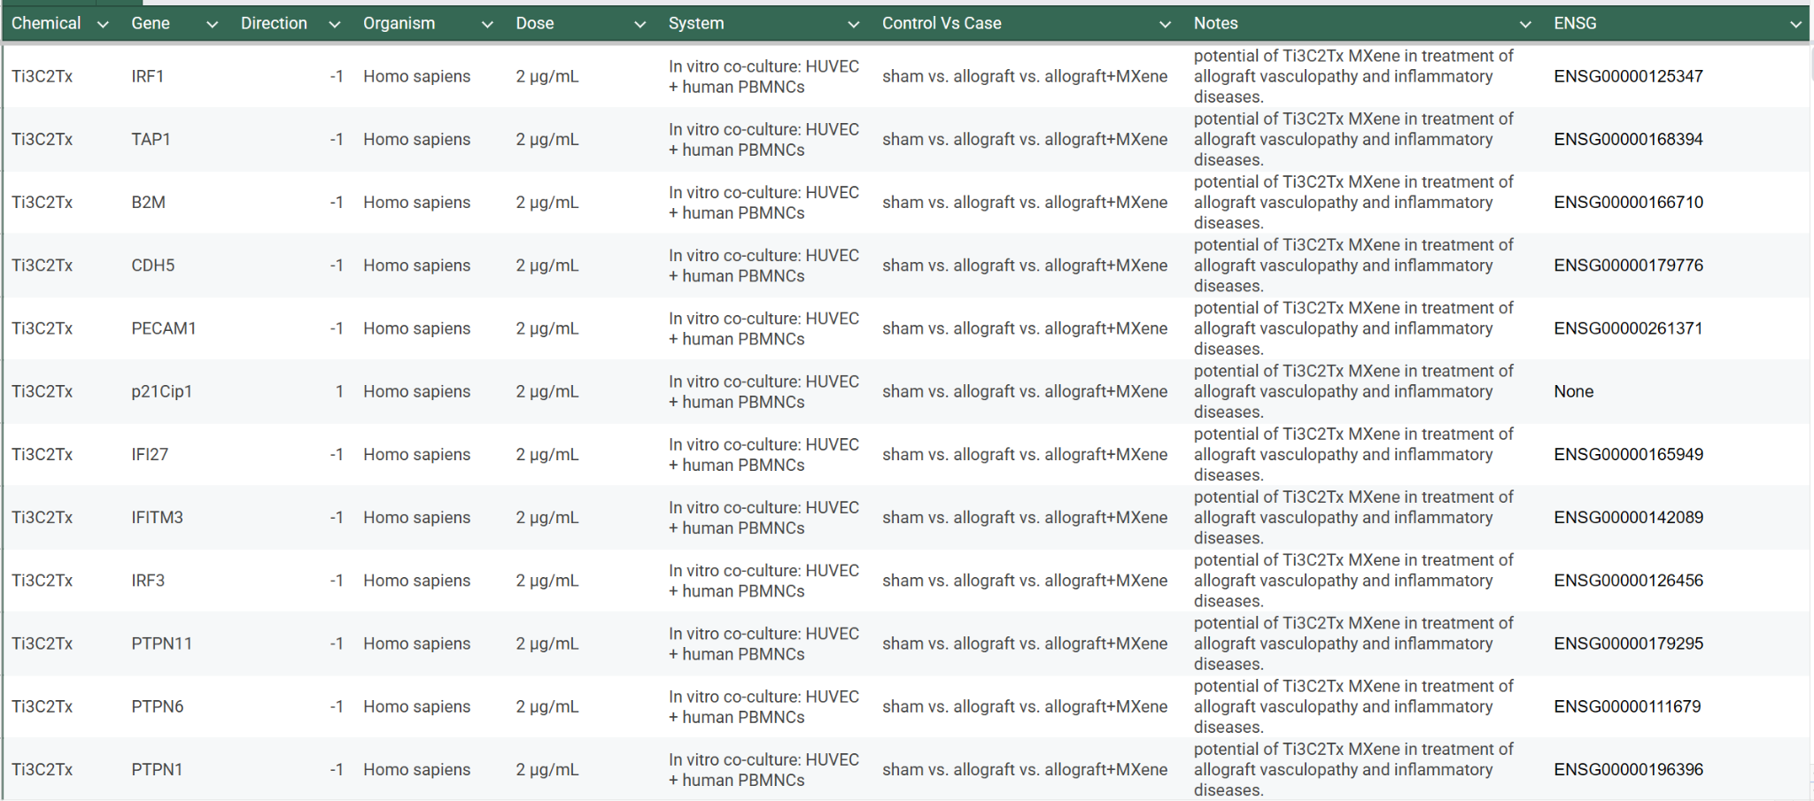
Curate Ti₃C₂Tx signature (PBMC) – URL

Slide 8
TF‑regulon expansion (Literature DEGs)
Expanded with DoRothEA A–C
Input ID=ENSEMBL
132 → 1043 genes (838 AB & 205 C)
TF expansion [Ti3C2Tx]: 126 → 704 genes (TFs matched: 8; targets added: 578)
TF expansion [HN-Ti3C2]: 24 → 339 genes (TFs matched: 1; targets added: 315)
TF (Ti3C2Tx) | n_targets | n_added | confidence
STAT1 | 290 | 255 | A
EGR1 | 124 | 121 | A
IRF2 | 76 | 70 | C
IRF3 | 74 | 70 | C
IRF4 | 68 | 65 | C
IRF1 | 32 | 25 | A
STAT2 | 39 | 21 | B
IRF9 | 12 | 3 | B
TF (HN-Ti3C2) | n_targets | n_added | confidence
E2F1 | 324 | 315 | A

Slide 9
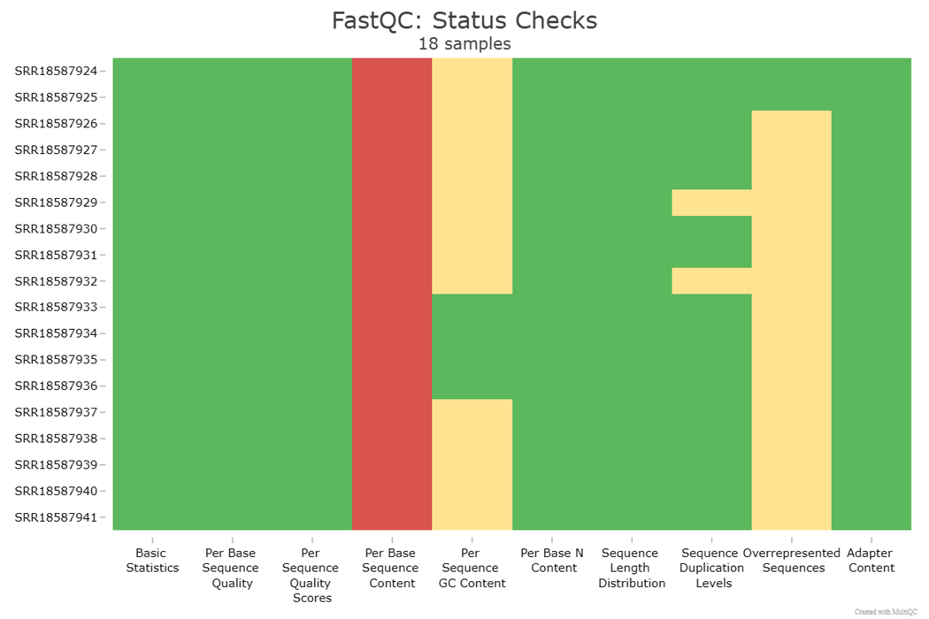
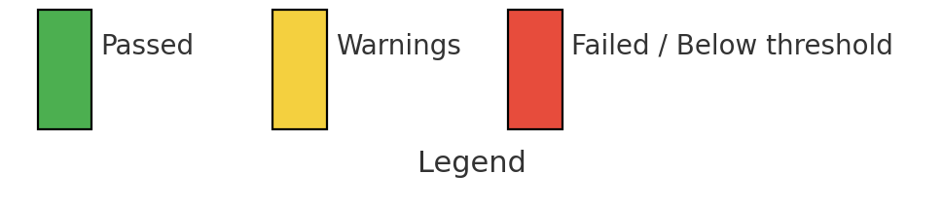
GEO PBMC (GSE200036) - QC
FastQC summary across 18 RNA-seq samples. Rows are samples and columns are FastQC modules.
Most libraries pass core metrics (basic stats, per-base quality), with common warnings in Per Base Sequence Content, GC Content, and Overrepresented Sequences, while adapter content appears largely acceptable.
Per-base sequence content shows an A/T enrichment (~30–35 bp) typical of RNA-seq composition/priming bias.
Notes:
Urgan porlak

Slide 10
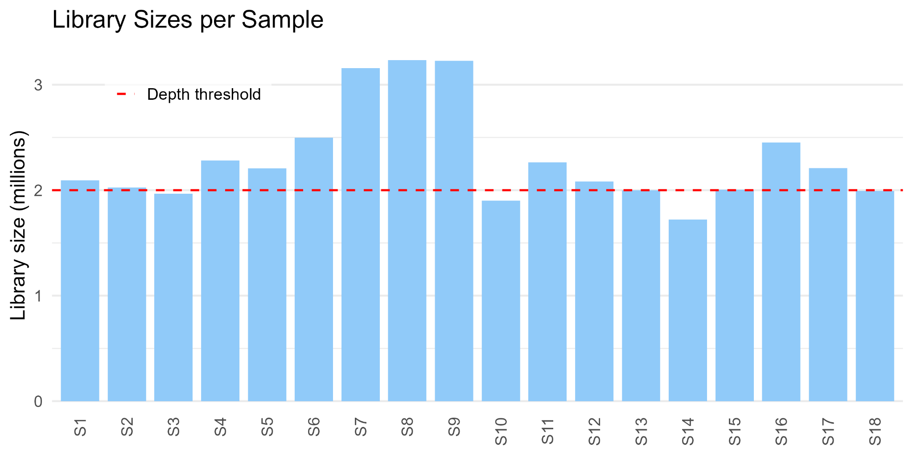
GEO PBMC (GSE200036) - Raw Counts Validation
Total samples: 18 (6 conditions × 3 replicates)
Library sizes: 1.7M–3.2M reads
2 low-depth samples flagged (ID7.MX1.T24.A, ID9.MX3.T24.B)
Replicates balanced across conditions
QC largely passed
Notes:
In vitro data can be used for PoD but not for drawing mechanistic insights
Study in the 2D dim is diff from 3D

Slide 11
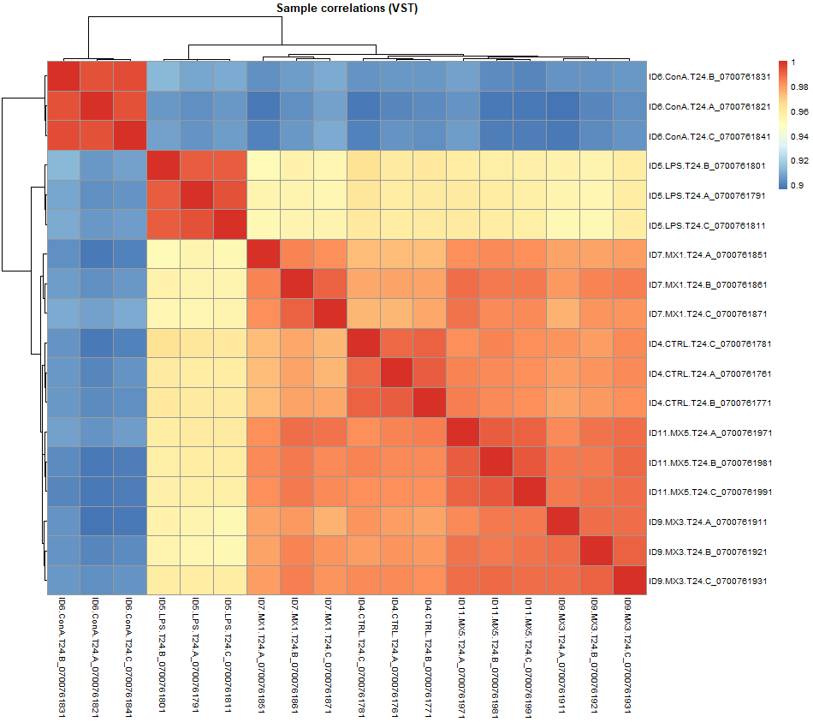
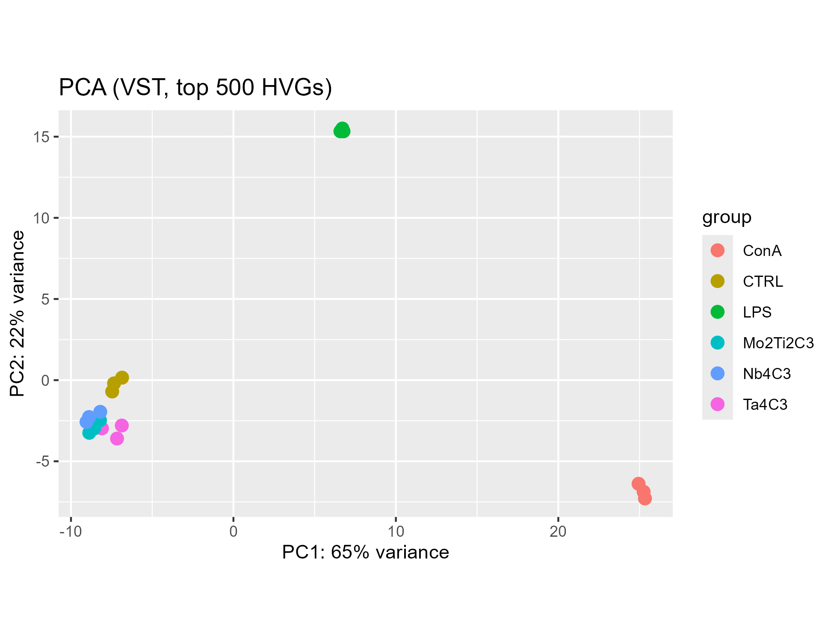
GEO PBMC (GSE200036) - Raw Counts Validation
Replicates cluster tightly by condition. ConA explains most variance (PC1), LPS separates on PC2, while MXene-exposed PBMCs remain close to controls—consistent with modest transcriptomic effects at 24 h.

Slide 12
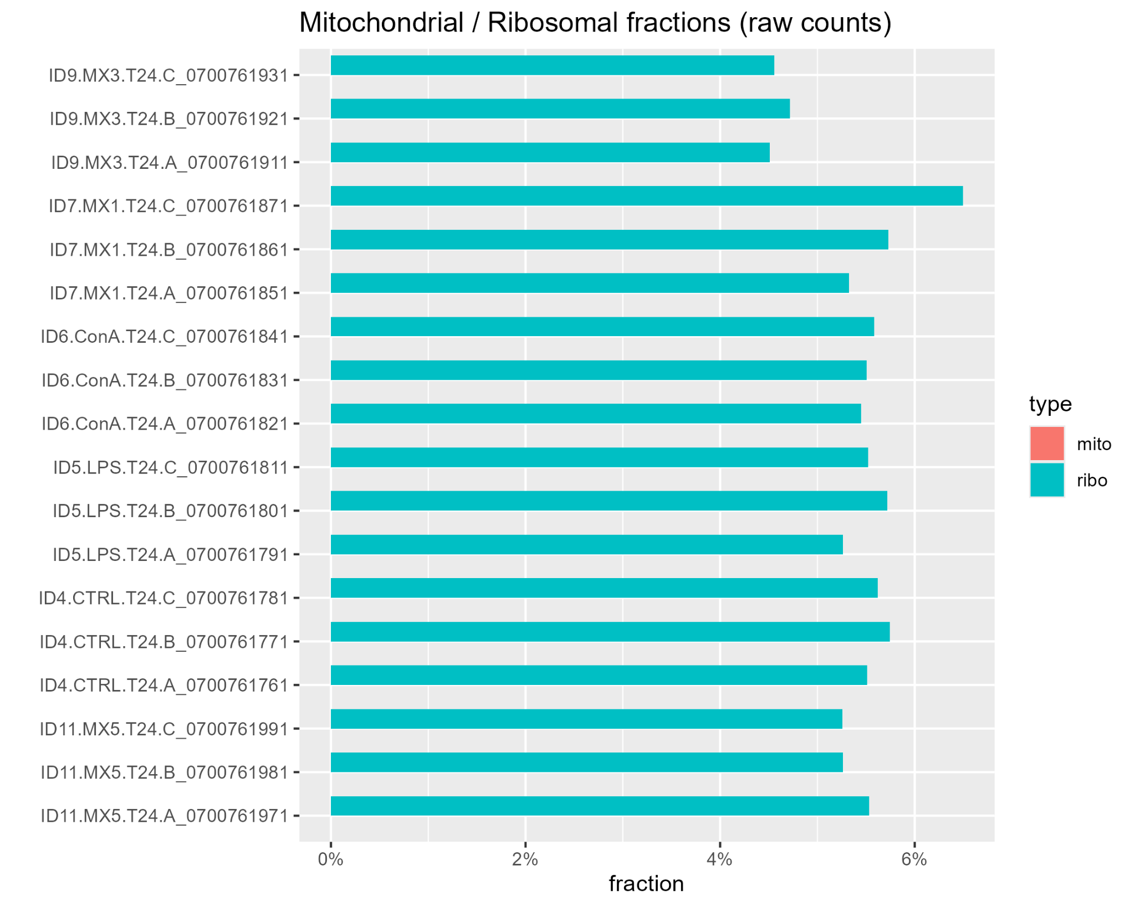
GEO PBMC (GSE200036) - Raw Counts Validation
Mitochondrial >10–15% in bulk can indicate RNA degradation or sample issues
Ribosomal a few percent is expected even with polyA selection; large values (e.g., >15–20%) could mean poor rRNA depletion or genomic contamination.

Slide 13
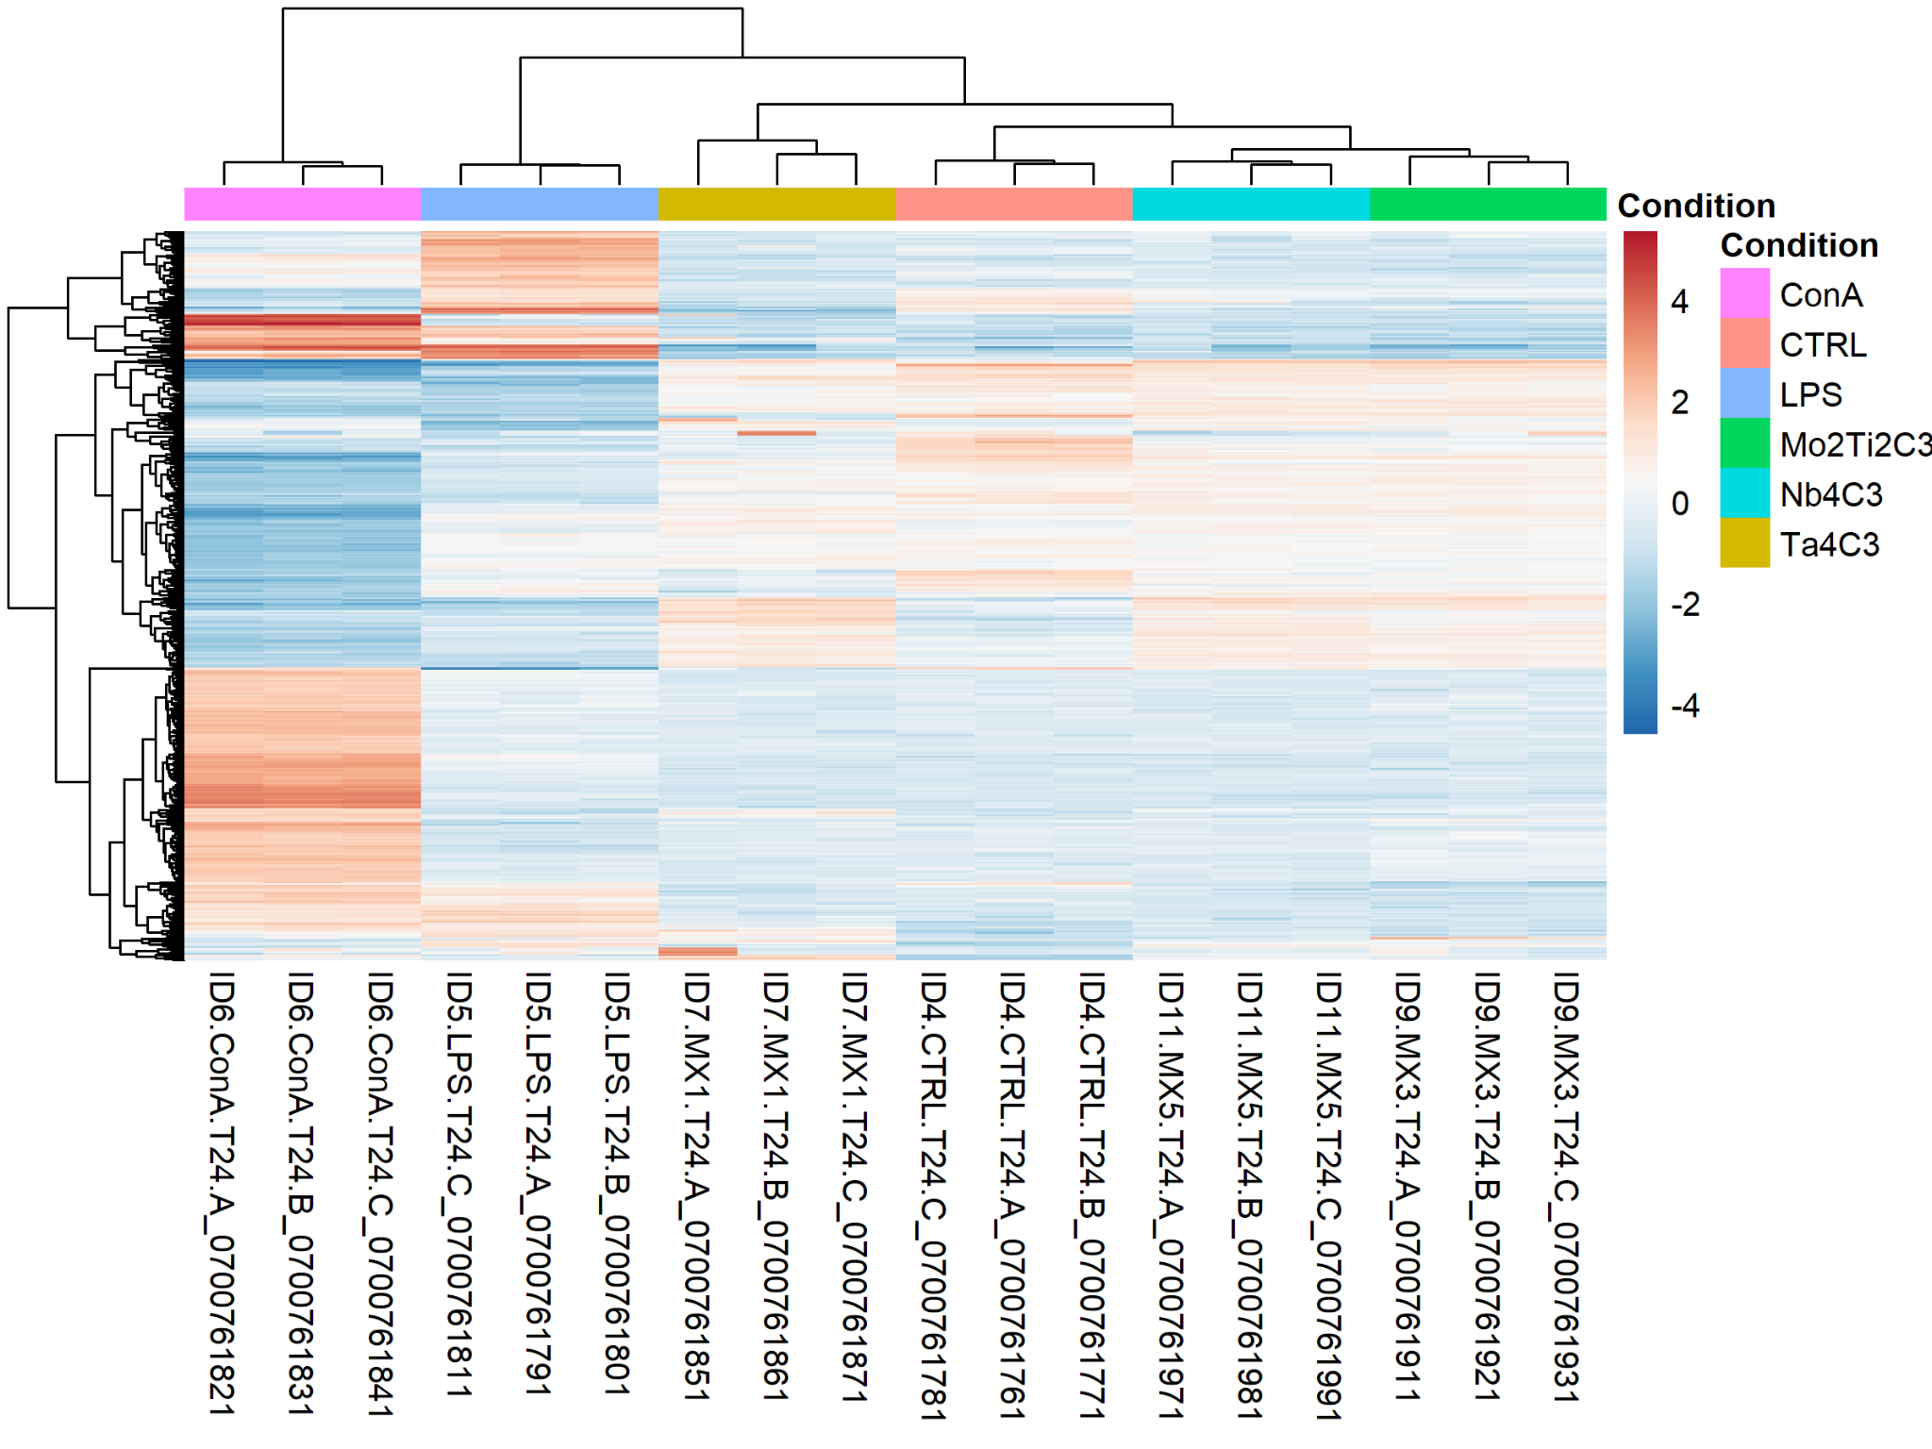
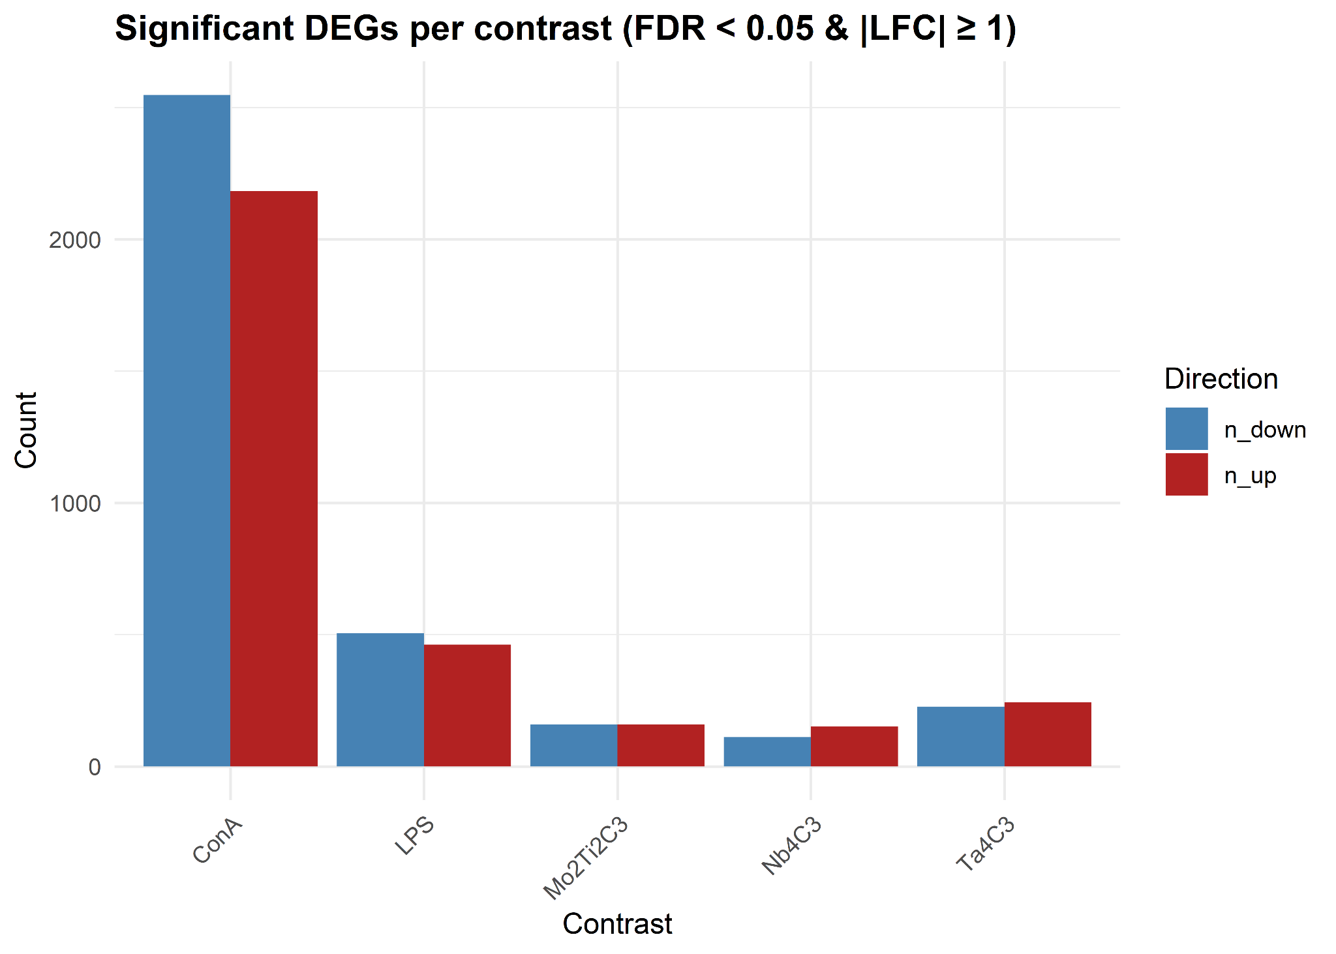
Preprocessing & DE
Samples cluster primarily by condition. ConA and LPS separate cleanly from CTRL. MXenes cluster closer to CTRL and partially to each other, consistent with smaller effect sizes. No obvious sample outliers—technical QC looks acceptable.
ConA is the strongest perturbation with thousands of DEGs, LPS is next—as expected for positive immune controls. MXenes induce fewer but measurable changes; Ta₄C₃ > Mo₂Ti₂C₃ ≈ Nb₄C₃ in magnitude. Up/down counts are fairly balanced, suggesting mixed activation/repression programs.

Slide 14
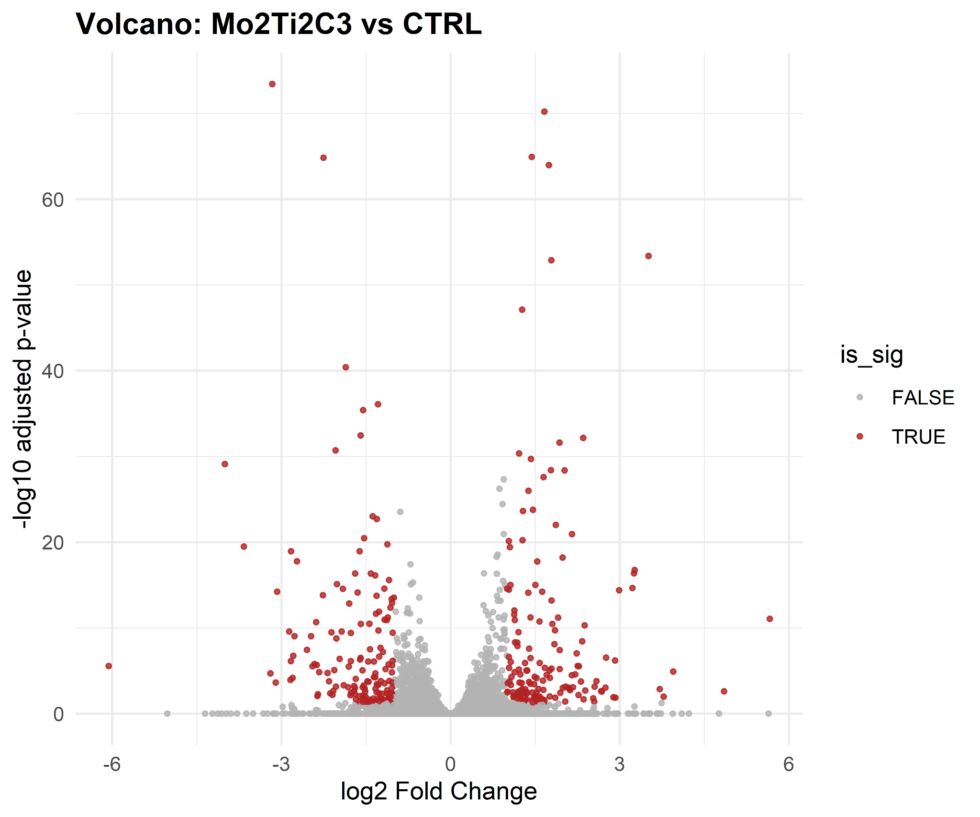
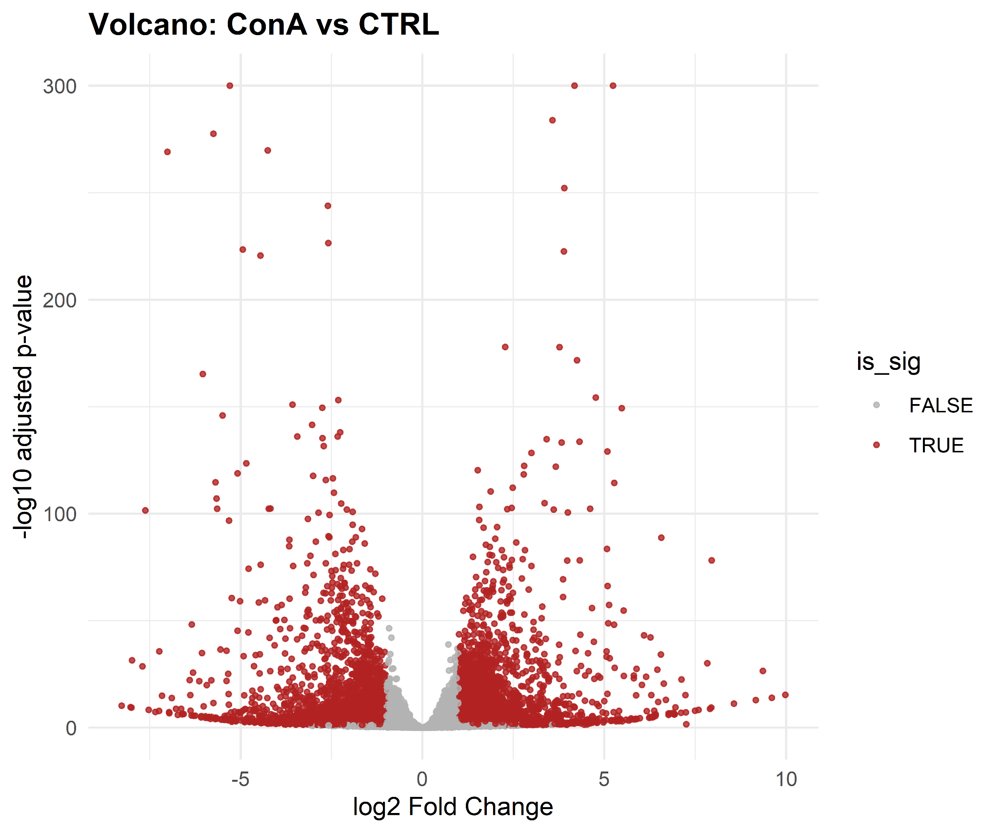
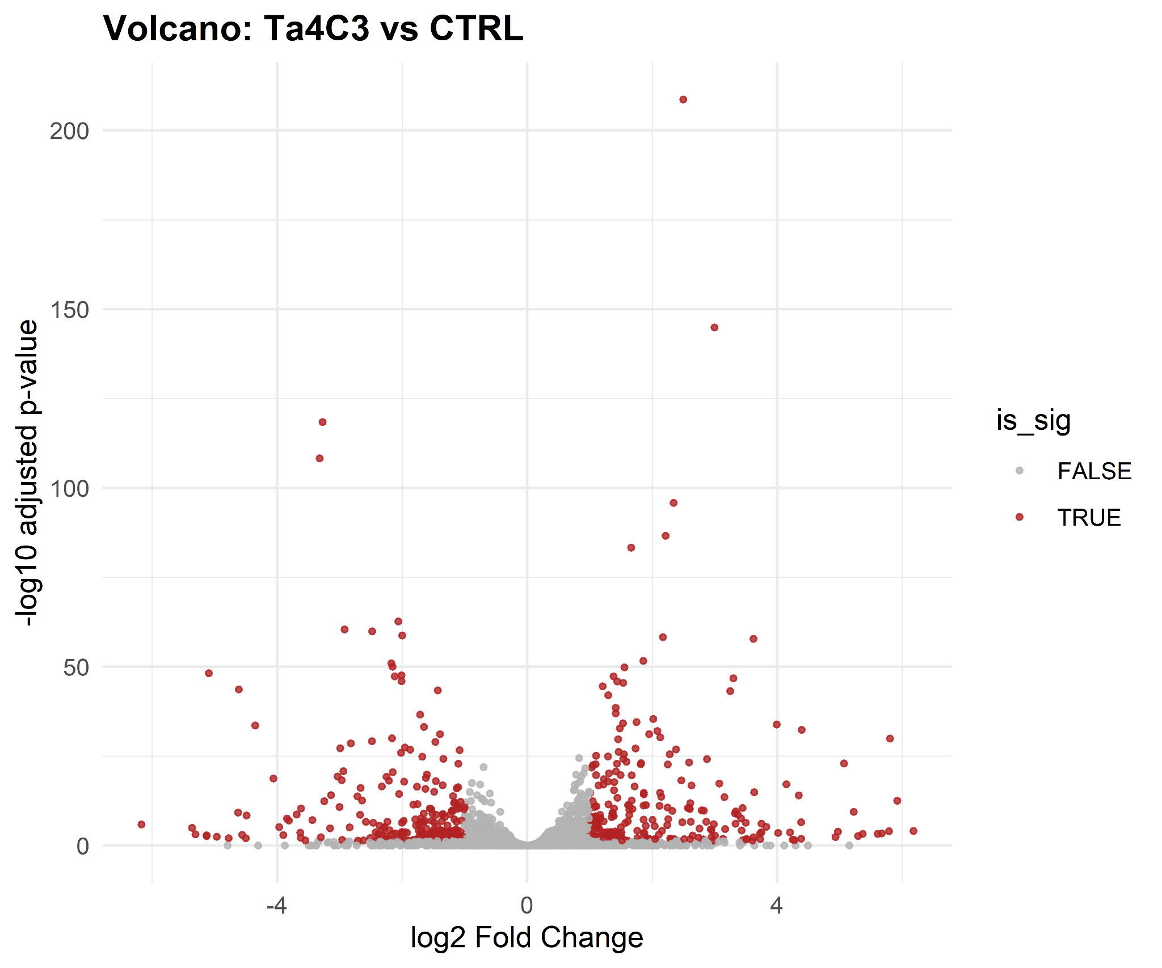
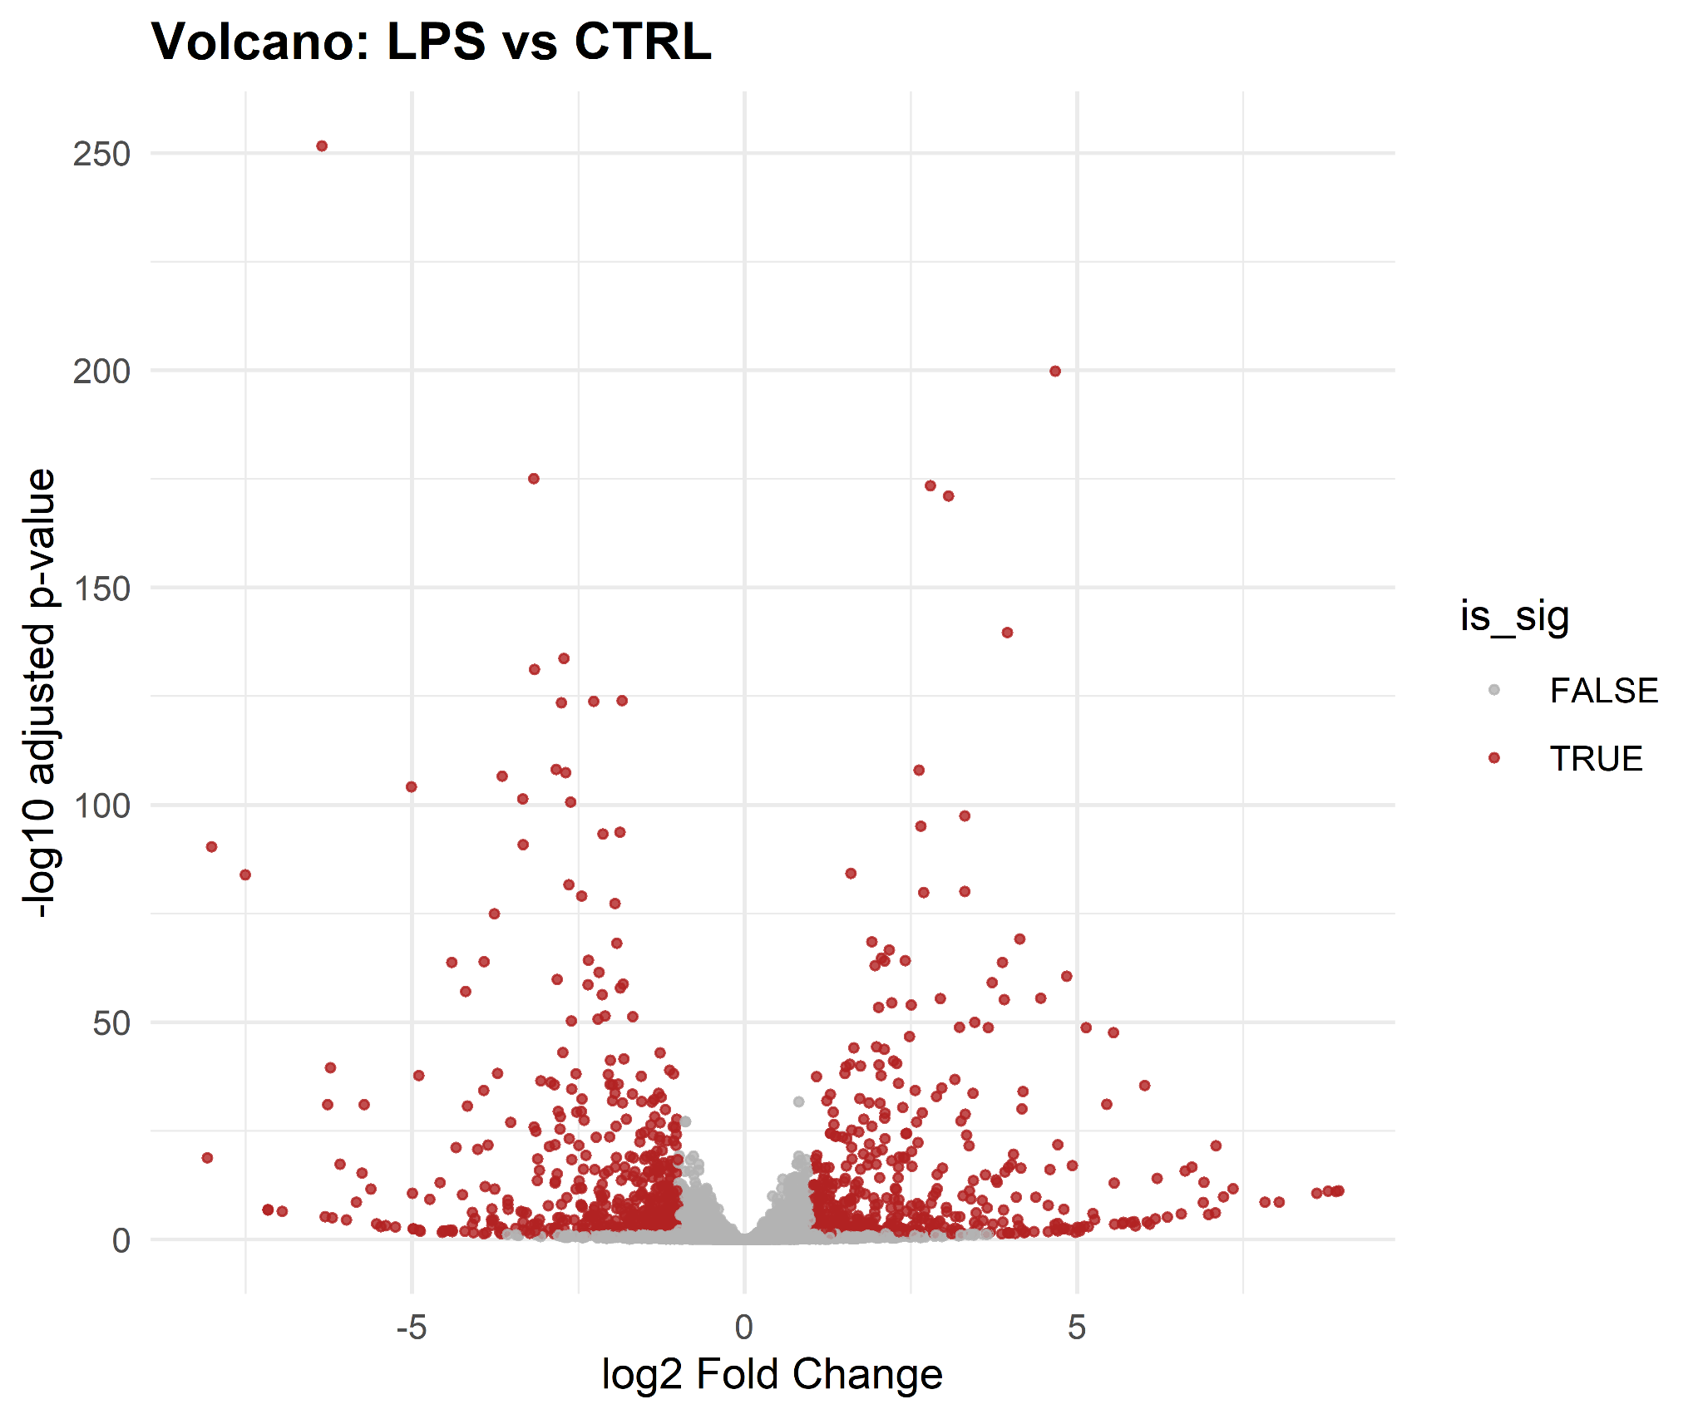
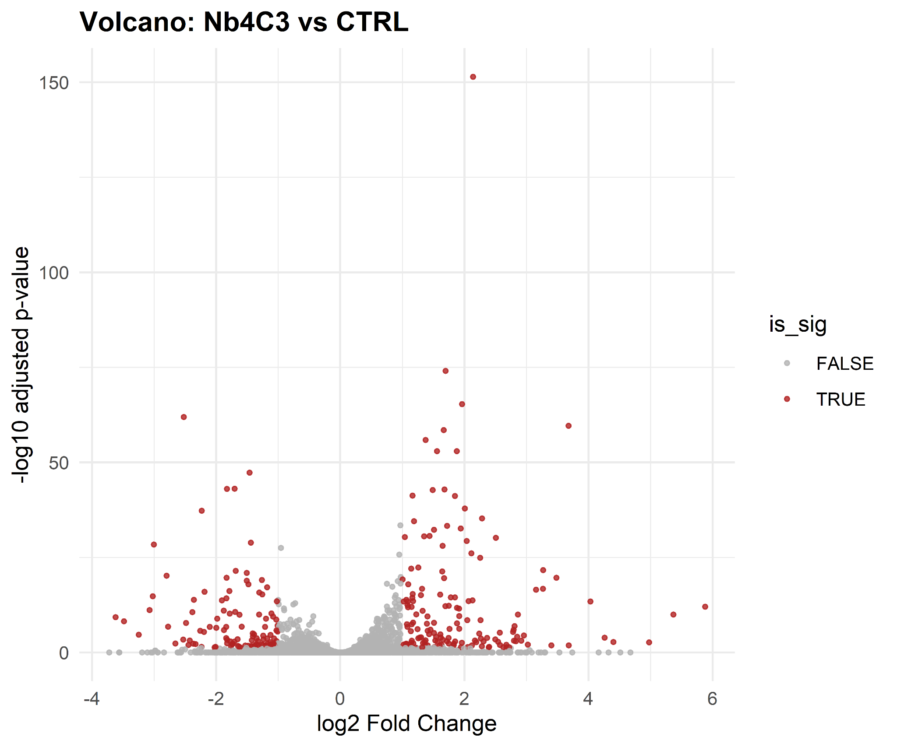
Differential Expression Analysis
Mo₂Ti₂C₃: “Moderate number of DEGs with a slight tilt toward upregulation; effects are concentrated, not genome-wide.”
Nb₄C₃: “Similar scale to Mo₂Ti₂C₃, modest but clear signal.”
Ta₄C₃: “Largest MXene signal among the three, both up and down shifts—good candidate for downstream KE/AOP mapping.”
ConA: “Very broad bidirectional response with many highly significant genes—our strongest positive control.”
LPS: “Large immune activation, fewer DEGs than ConA but still robust—second positive control behaves as expected.”

Slide 15
Functional Enrichment
(Literature DEGs + DE Analysis)
All figures are available in drive in PNG and PDF formats that are more clear than the slides https://drive.google.com/drive/folders/1lP-2EUZKbQchOfedCiZ8OXBNPdcLbK_z?usp=sharing

Slide 16
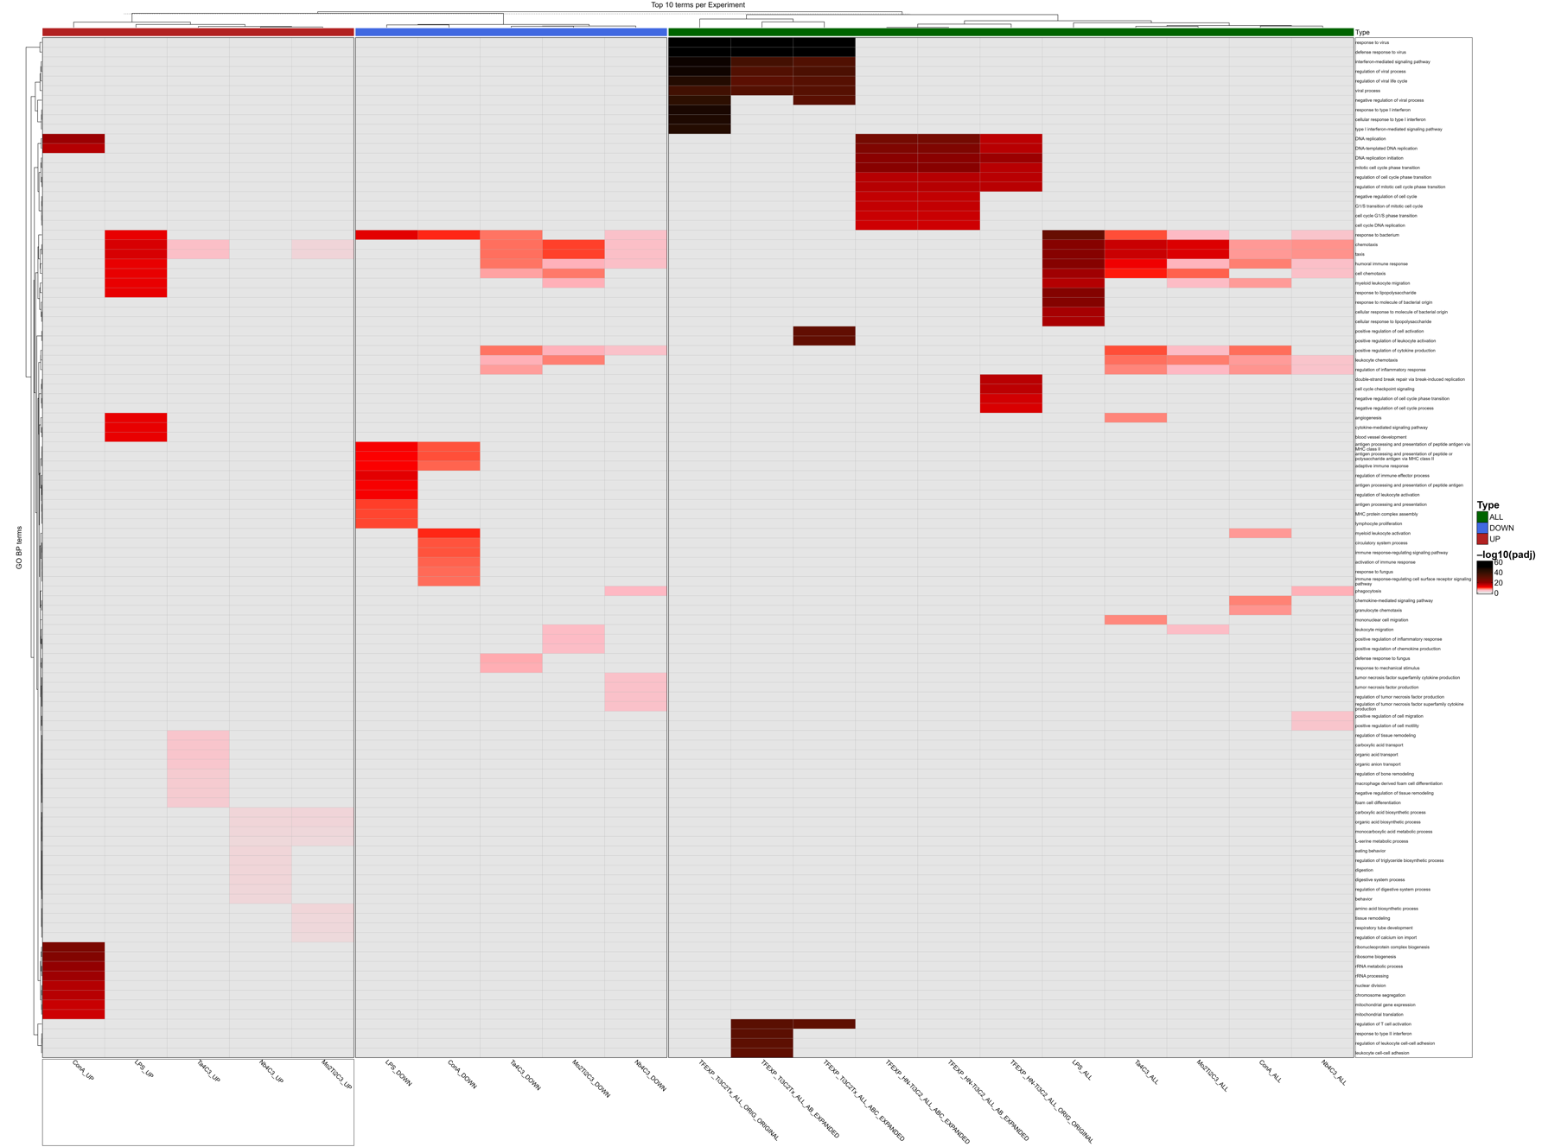
Top GO Biological Processes

Slide 17
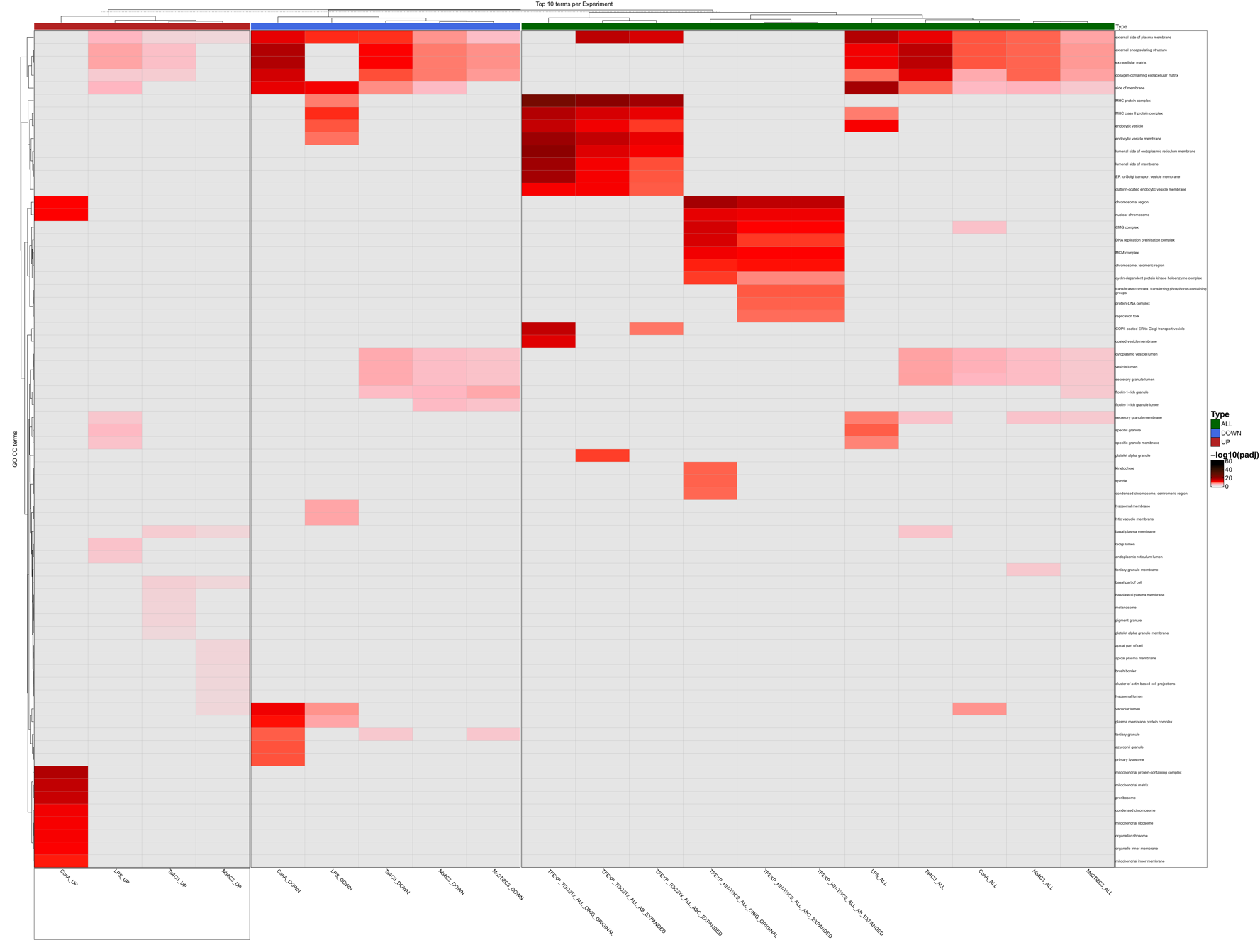
Top GO Cellular Components

Slide 18
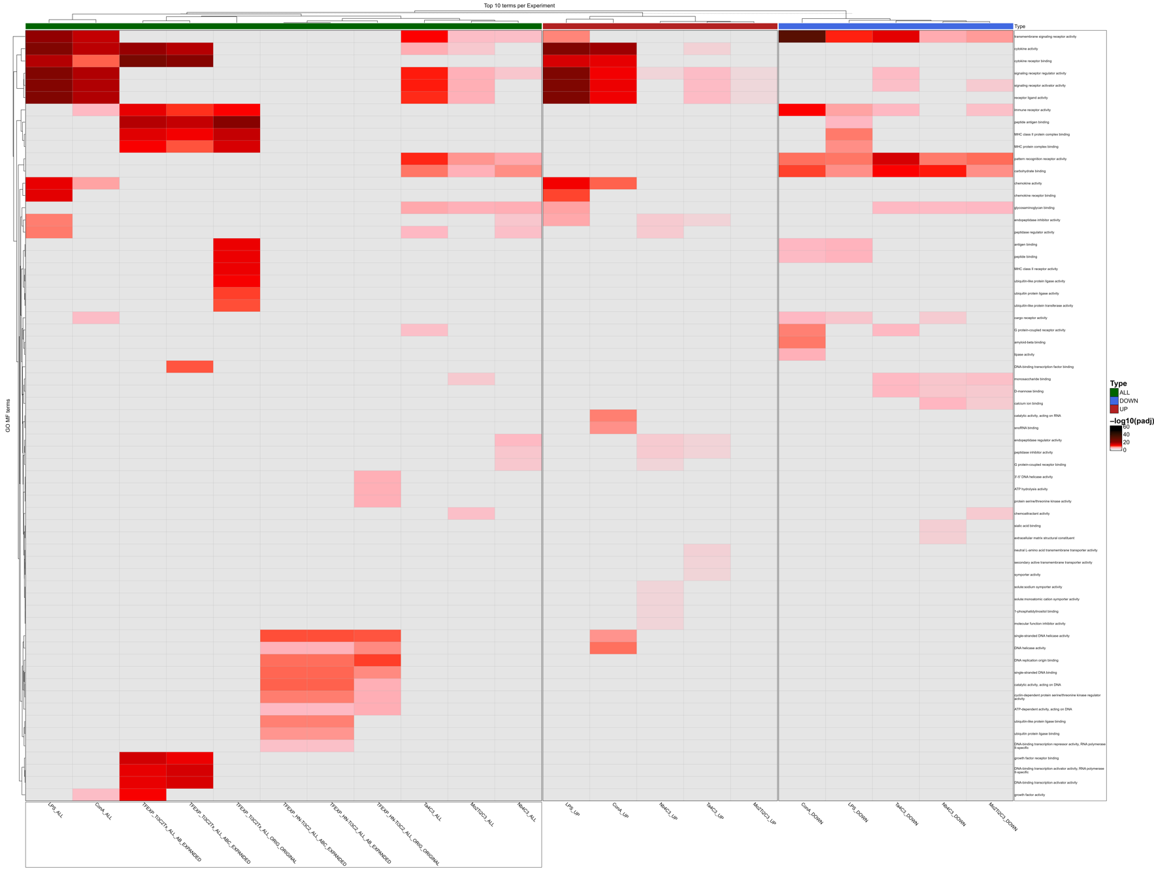
Top GO Molecular
Functions

Slide 19
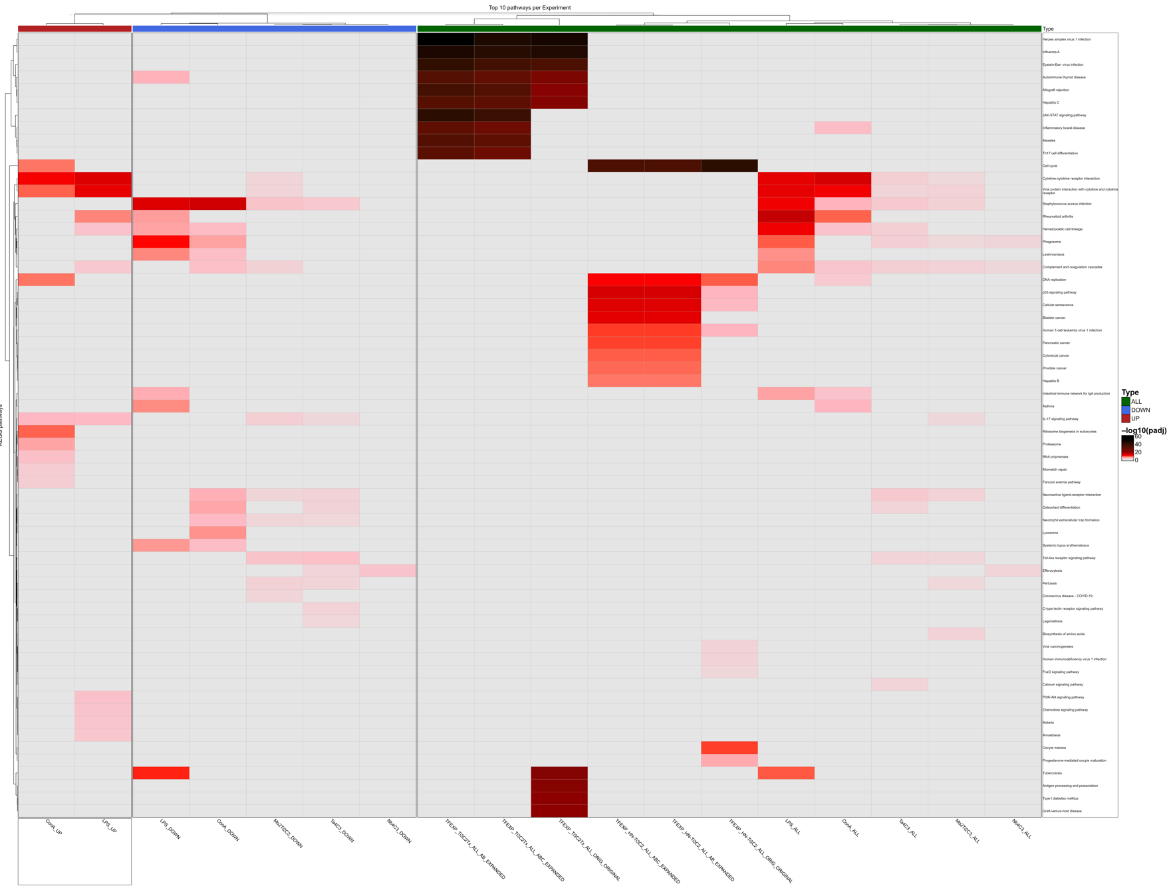
Top KEGG Pathways

Slide 20
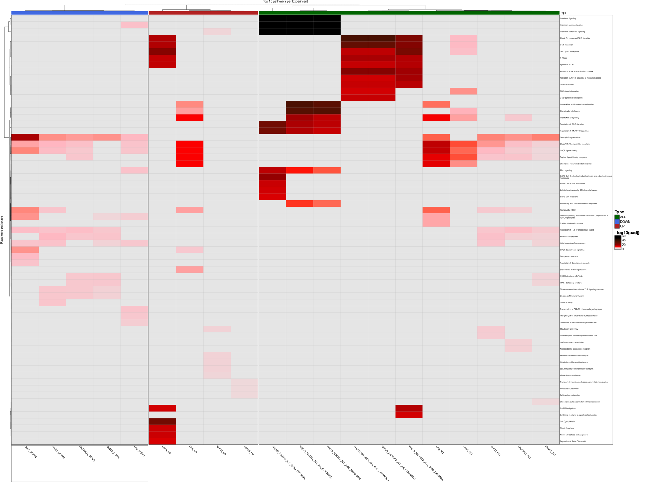
Top Reactome Pathways

Slide 21
AOP Fingerprinting
(Literature DEGs + DE Analysis)
All figures are available in drive (under the AOP folder) in PNG and PDF formats that are more clear than the slides https://drive.google.com/drive/folders/1lP-2EUZKbQchOfedCiZ8OXBNPdcLbK_z?usp=sharing

Slide 22
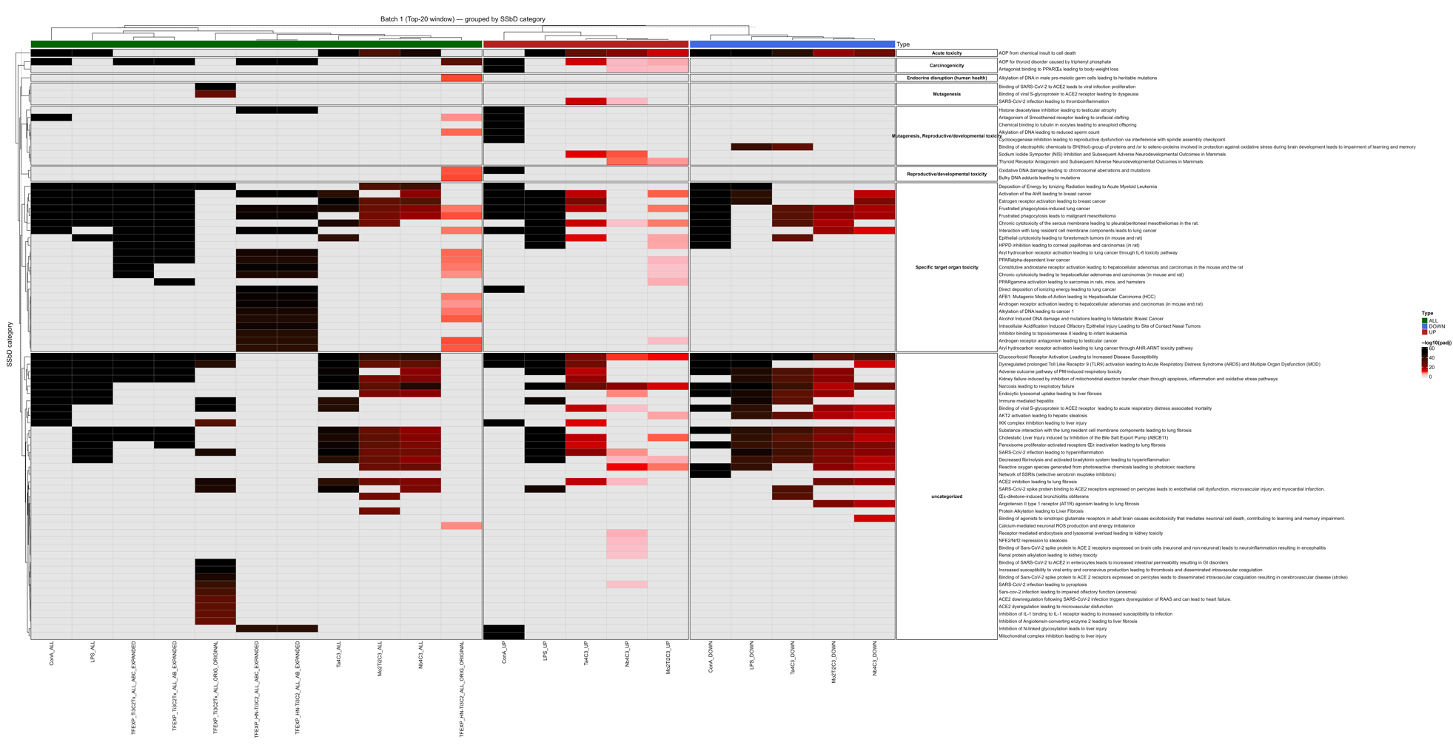

Slide 23
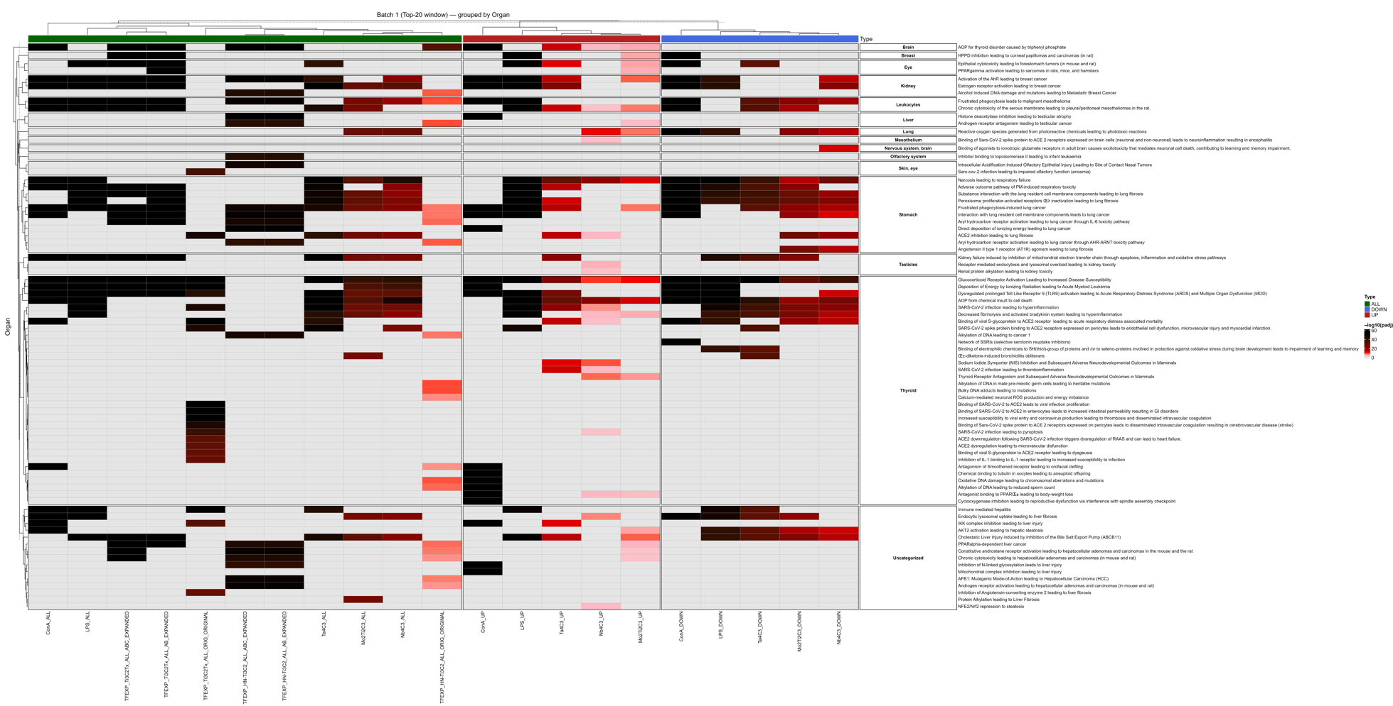

Slide 24
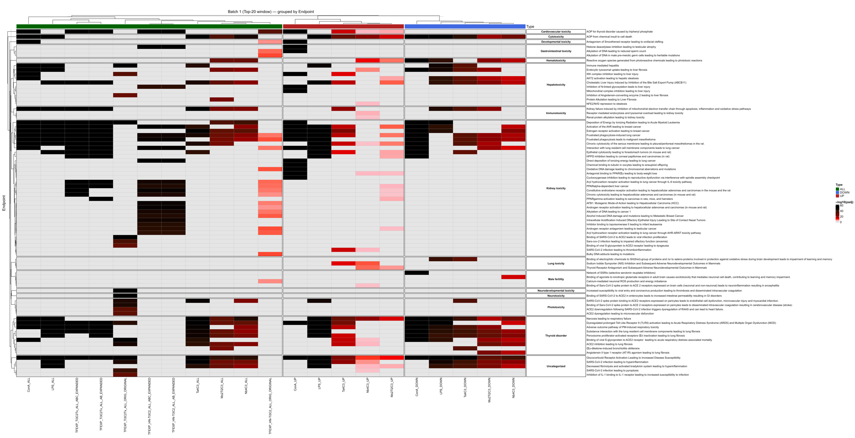

Slide 25
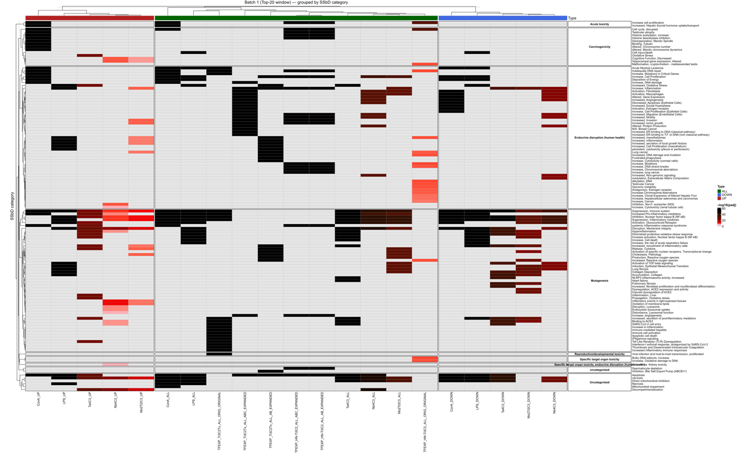

Slide 26
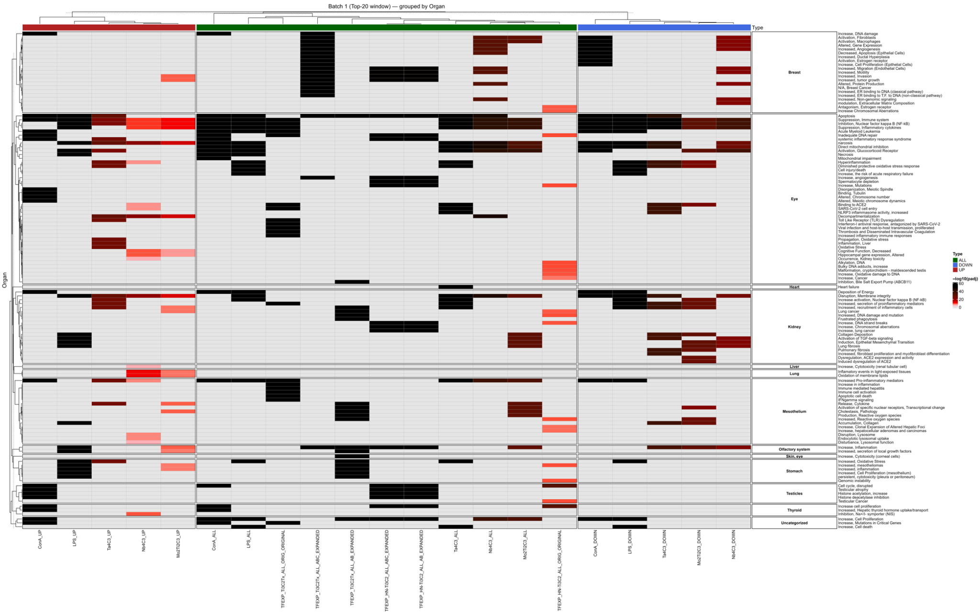

Slide 27
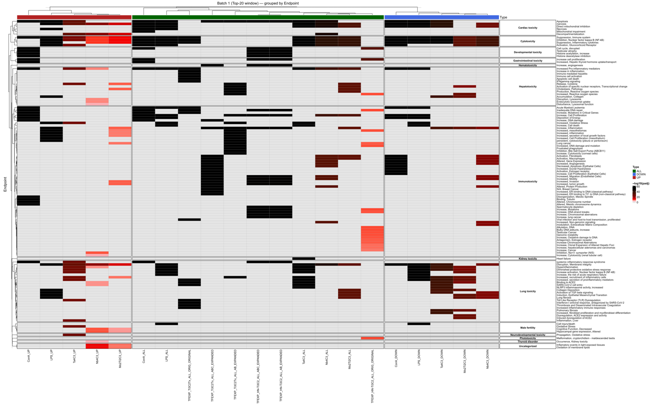

Slide 28
AOP Network Visualization using AOPfingerprintR
All networks are available in drive (under the “AOP_Networks” folder) in interactive html format. https://drive.google.com/drive/folders/17F5_6xlBZv_axkV2aZFK5kzJGFKg632P?usp=sharing

Slide 29
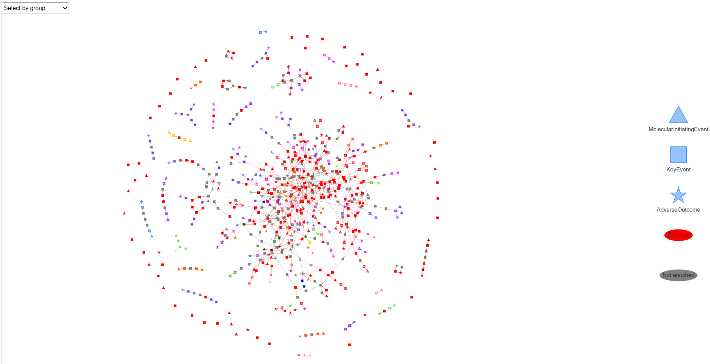

Slide 30
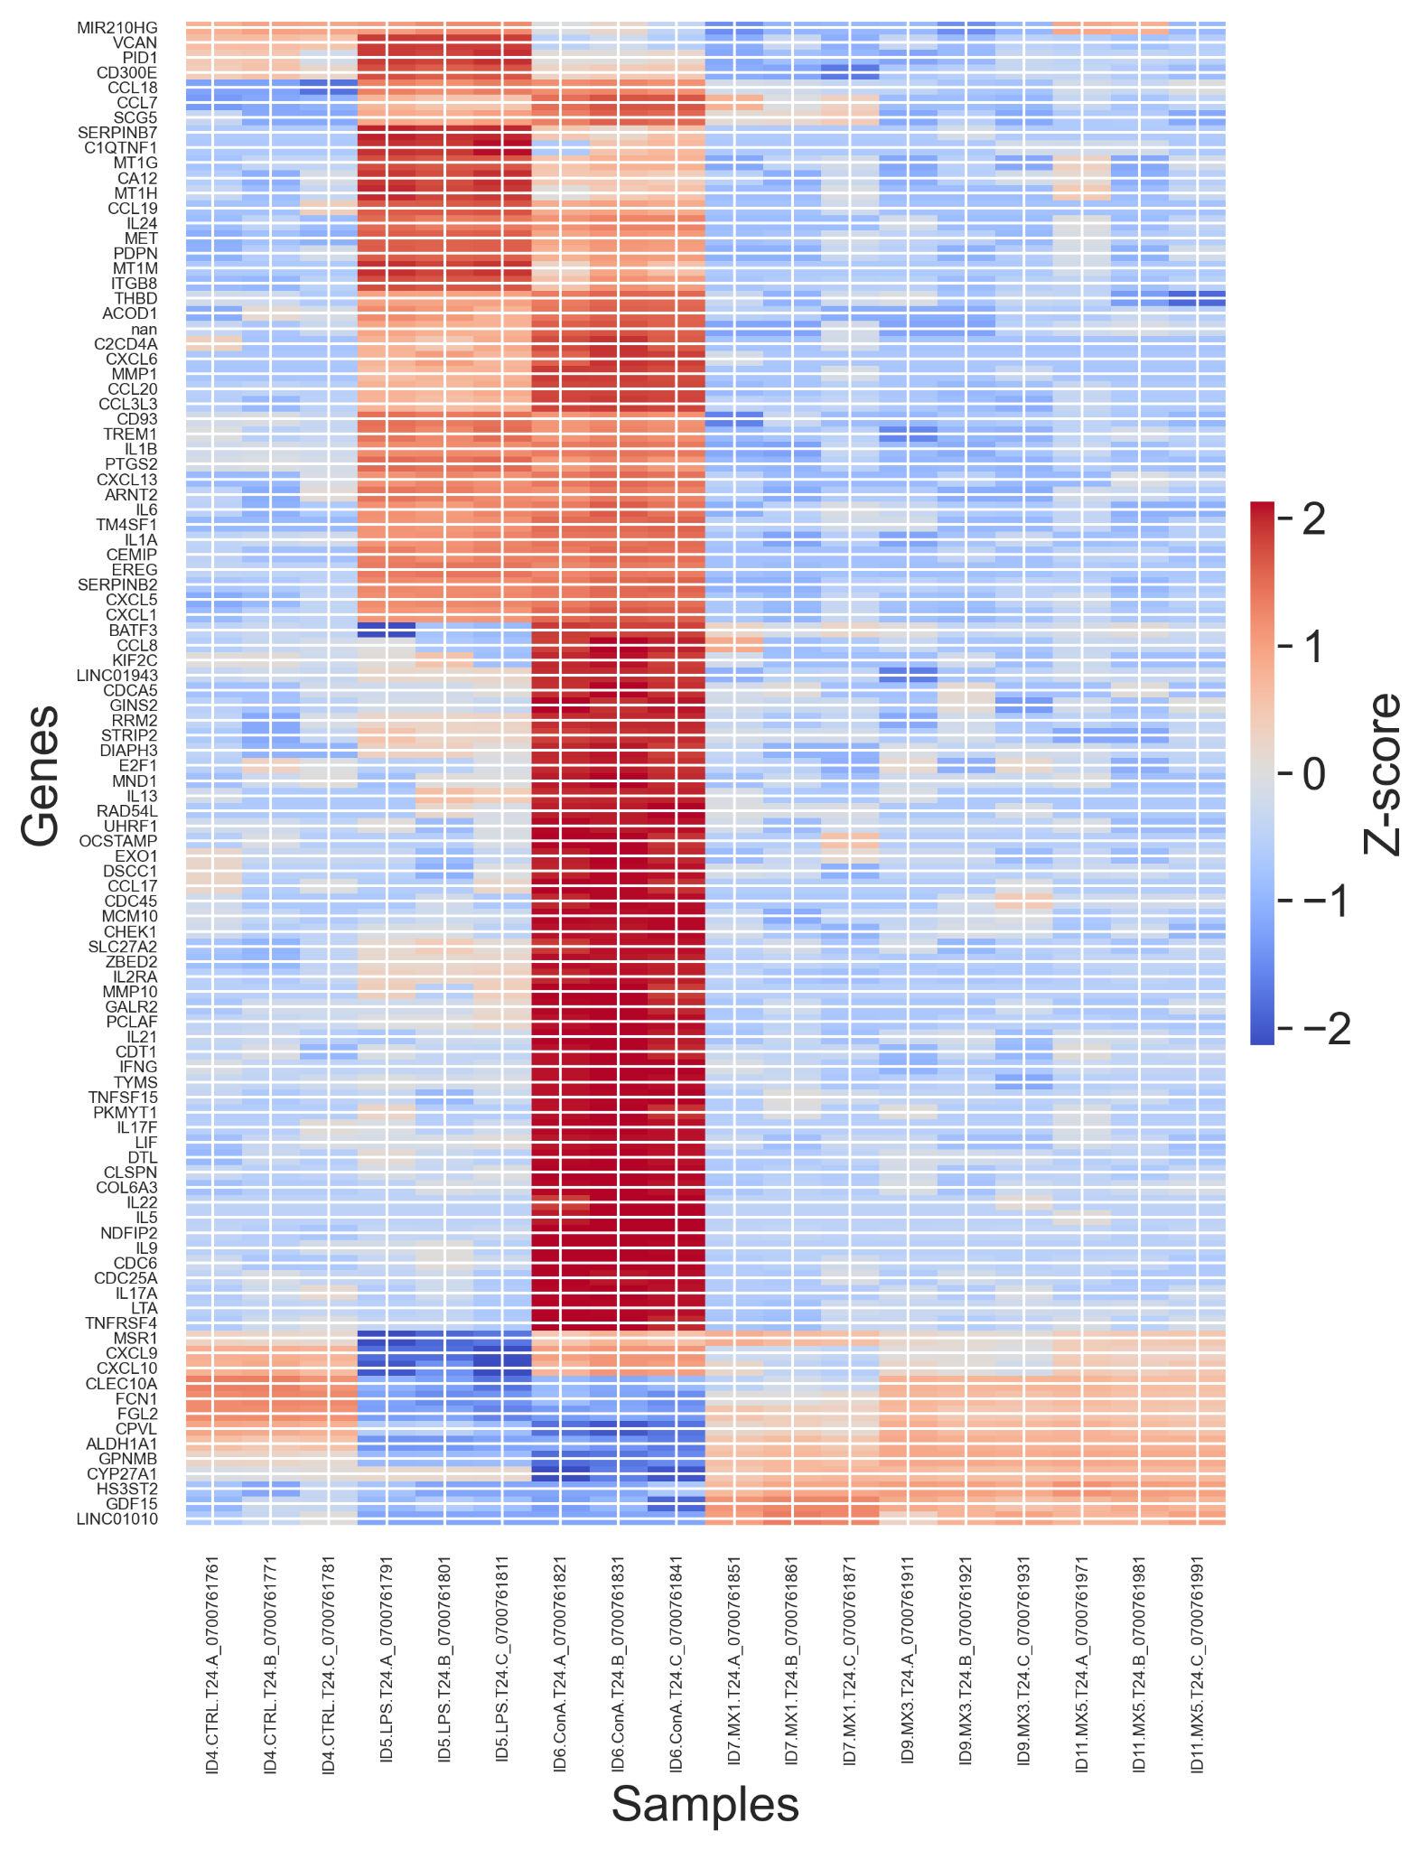

Slide 31
References
Gogotsi, Y., & Huang, Q. (2021). MXenes: Two-dimensional building blocks for future materials and devices. ACS Nano, 15(4), 5775–5780. https://doi.org/10.1021/acsnano.1c03161
Love MI, Huber W, Anders S. DESeq2. Genome Biol (2014) doi:10.1186/s13059-014-0550-8
The Gene Ontology Consortium. Gene Ontology resource. Nat Genet (2021) doi:10.1038/s41588-021-00931-5.
Kanehisa M, Goto S. KEGG. Nucleic Acids Res (2000); updates e.g. 2019/2021 NAR.
Jassal B, et al. Reactome. Nucleic Acids Res (2020).
Gu Z, Eils R, Schlesner M. ComplexHeatmap. Bioinformatics (2016) 32:2847–2849.
Gu Z. circlize. Bioinformatics (2014).
Kolde R. pheatmap (R package), if you used it anywhere.
Andrews, S. FastQC: A Quality Control Tool for High Throughput Sequence Data. Babraham Bioinformatics, Babraham Institute; version 0.12.1. Available at: https://www.bioinformatics.babraham.ac.uk/projects/fastqc/
Ewels, P. A., Magnusson, M., Lundin, S., & Käller, M. MultiQC: Summarize analysis results for multiple tools and samples in a single report. Bioinformatics 32(19): 3047–3048 (2016).
MultiQC software; version 1.16. Available at: https://multiqc.info (accessed 28 Sep 2025).
All used software versions and details for the performed analysis are available in Drive.

Slide 32



Thank you!
asmaa@edelweissconnect.com
asmaa-a-abdelwahab
asmaa-a-abdelwahab

